Slide 1
Value-Added Services Icon Sets
Preset icon sets with instructions for customization & saving

Slide 2
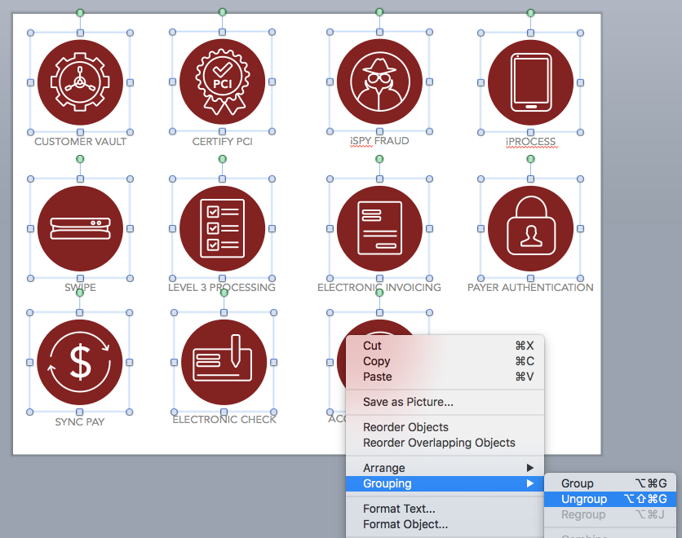
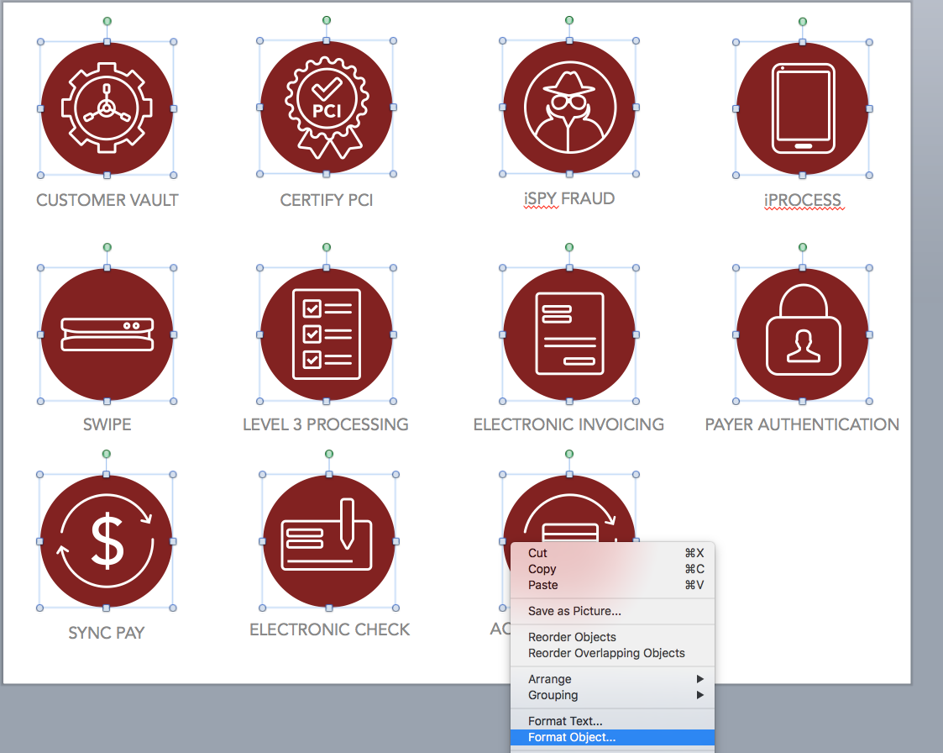
Customize the color of the icons
Step 1: Navigate to any of the existing icon sets (slides 7 -17)
Step 2: Ungroup all of the colored circles from the white icons
Hold down the shift key and select all of the icon sets. Note: do not include the text boxes in your selection.
Release the shift key and right-click on one of the icons.
Select Grouping > Ungroup
Step 3: Click anywhere on the white space of the slide to release the selection of all the items.
Step 4: Select ONLY the colored circles
Hold down the shift key and select all of the colored circles. Be careful to no select any of the white icons. Tip: click on the outer area of the circles when selecting them.
Release the shift key and right-click just outside of one of the circles
Select Format Object

Slide 3
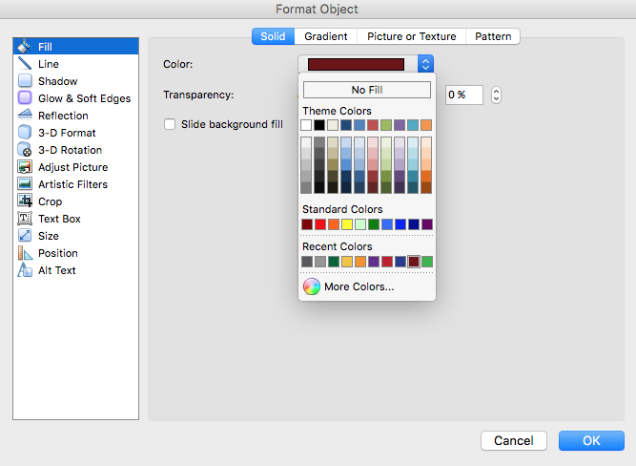
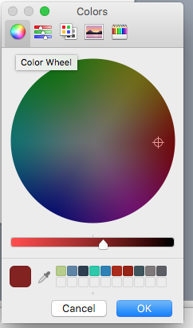
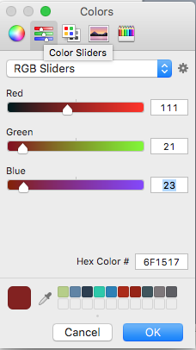
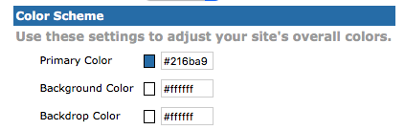
Customize the color of the icons
Step 5: Select the color you want
Make sure Fill is selected in the left hand column and then select the drop down box next to Color.
  Option 1: Choose one of the suggested colors shown in the drop down box if one is suitable
  Option 2: Select More Colors at the bottom of the pop up window for custom color options.
If you go with option 2, we recommend using the Color Wheel (first tab) or the Color Sliders (second tab)
  If want to use the Hex Color # (recommended) it can be accessed on the Color Sliders tab. This is the most accurate way to ensure the exact color you want.
  Tip: if you are unsure of the Hex Color # and have branded your gateway account, chances are the color you are looking to make your logos has also been used when branding your gateway account. To access the Hex Color # you have set for your gateway account, simply log in and navigate to Options > Look and Feel > Color Schemes and pull your desired Hex Color # (it’s probably the Primary Color). Note: do not include the “#” sign when entering it into PowerPoint.
Hex Color in the Gateway

Slide 4
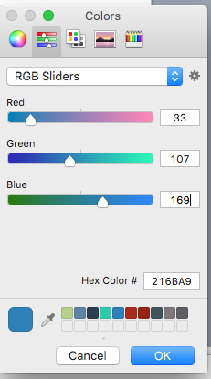
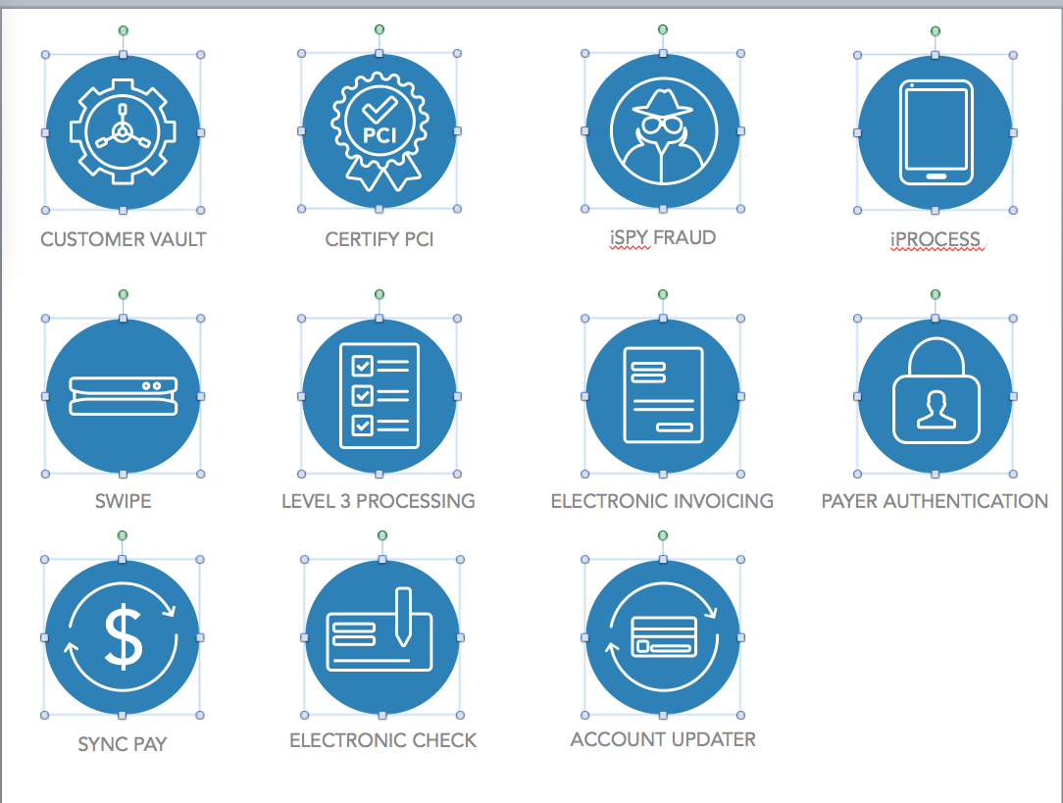
Customize the color of the icons
Step 5 Continued (Walking through Option 2)
Let’s walk through using the Hex Color # to change the color of the icons. Let’s use the Primary Color set for this gateway, which is Hex Color #216BA9
  I entered the above Hex Color #216BA9 into the appropriate field on the Color Sliders tab.
  Tip: If you don’t see the color change in the lower left hand square of this tab, click into the Blue field which should prompt the change. Click OK, then click OK again in the Format Object box.
  Your icons should now be the color you want them to be!
Hex Color in the Gateway

Slide 5
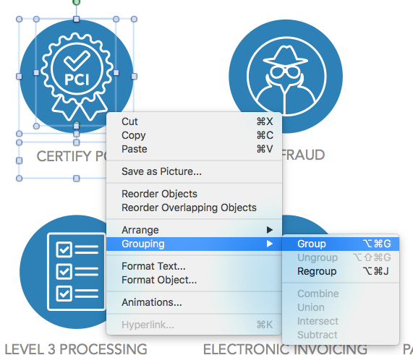
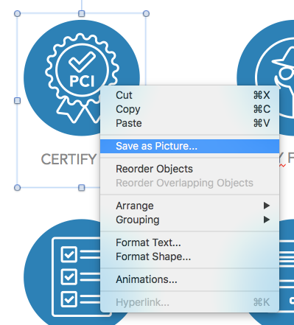
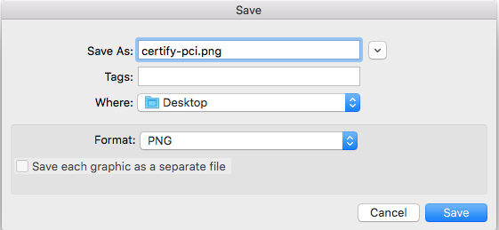
Save the Icons with Product Names
(See the next slide for how to save icons without product names)
Step 1: Group the text with the icons
Note: This step will have to be done individually for each icon set
Hold down the shift key and select the colored circle, white icon and text.
Release the shift key and right-click anywhere on the selected items
Select Grouping > Group (or Regroup)
Repeat these steps for each icon set
Step 2: Save each icon set
Click on an icon (you will notice everything is all one item now) and right-click on it.
Select Save as Picture
Name the file and select where you’d like the icon to be saved to and the file format you would like.
Select Save
Repeat these steps for each icon set

Slide 6
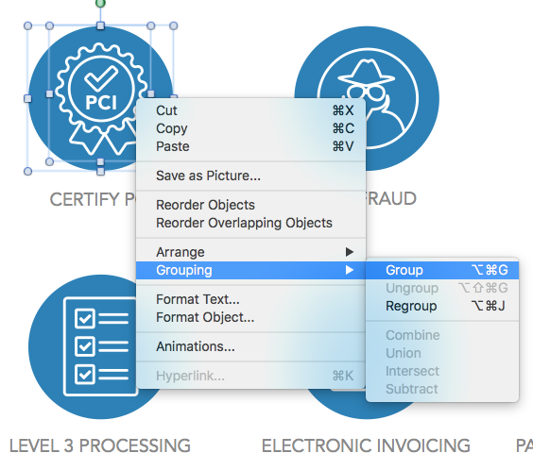

Save the Icons without Product Names
Step 1: Regroup the colored circles and white icons
Note: This step will have to be done individually for each icon
Hold down the shift key and select both the colored circle and white icon
Release the shift key and right-click anywhere on the selected items
Select Grouping > Group (or Regroup)
Repeat these steps for each icon
Step 2: Save each icon
Click on an icon (you will notice the colored circle and white icon are one item now) and right-click on it.
Select Save as Picture
Name the file and select where you’d like the icon to be saved to and the file format you would like.
Select Save
Repeat these steps for each icon

Slide 7
CUSTOMER VAULT
CERTIFY PCI
iSPY FRAUD
iPROCESS
SWIPE
LEVEL 3 PROCESSING
ELECTRONIC INVOICING
PAYER AUTHENTICATION
SYNC PAY
ELECTRONIC CHECK
ACCOUNT UPDATER

Slide 8
CUSTOMER VAULT
CERTIFY PCI
iSPY FRAUD
iPROCESS
SWIPE
LEVEL 3 PROCESSING
ELECTRONIC INVOICING
PAYER AUTHENTICATION
SYNC PAY
ELECTRONIC CHECK
ACCOUNT UPDATER

Slide 9
CUSTOMER VAULT
CERTIFY PCI
iSPY FRAUD
iPROCESS
SWIPE
LEVEL 3 PROCESSING
ELECTRONIC INVOICING
PAYER AUTHENTICATION
SYNC PAY
ELECTRONIC CHECK
ACCOUNT UPDATER

Slide 10
CUSTOMER VAULT
CERTIFY PCI
iSPY FRAUD
iPROCESS
SWIPE
LEVEL 3 PROCESSING
ELECTRONIC INVOICING
PAYER AUTHENTICATION
SYNC PAY
ELECTRONIC CHECK
ACCOUNT UPDATER

Slide 11
CUSTOMER VAULT
CERTIFY PCI
iSPY FRAUD
iPROCESS
SWIPE
LEVEL 3 PROCESSING
ELECTRONIC INVOICING
PAYER AUTHENTICATION
SYNC PAY
ELECTRONIC CHECK
ACCOUNT UPDATER

Slide 12
CUSTOMER VAULT
CERTIFY PCI
iSPY FRAUD
iPROCESS
SWIPE
LEVEL 3 PROCESSING
ELECTRONIC INVOICING
PAYER AUTHENTICATION
SYNC PAY
ELECTRONIC CHECK
ACCOUNT UPDATER

Slide 13
CUSTOMER VAULT
CERTIFY PCI
iSPY FRAUD
iPROCESS
SWIPE
LEVEL 3 PROCESSING
ELECTRONIC INVOICING
PAYER AUTHENTICATION
SYNC PAY
ELECTRONIC CHECK
ACCOUNT UPDATER

Slide 14
CUSTOMER VAULT
CERTIFY PCI
iSPY FRAUD
iPROCESS
SWIPE
LEVEL 3 PROCESSING
ELECTRONIC INVOICING
PAYER AUTHENTICATION
SYNC PAY
ELECTRONIC CHECK
ACCOUNT UPDATER

Slide 15
CUSTOMER VAULT
CERTIFY PCI
iSPY FRAUD
iPROCESS
SWIPE
LEVEL 3 PROCESSING
ELECTRONIC INVOICING
PAYER AUTHENTICATION
SYNC PAY
ELECTRONIC CHECK
ACCOUNT UPDATER

Slide 16
CUSTOMER VAULT
CERTIFY PCI
iSPY FRAUD
iPROCESS
SWIPE
LEVEL 3 PROCESSING
ELECTRONIC INVOICING
PAYER AUTHENTICATION
SYNC PAY
ELECTRONIC CHECK
ACCOUNT UPDATER

Slide 17
CUSTOMER VAULT
CERTIFY PCI
iSPY FRAUD
iPROCESS
SWIPE
LEVEL 3 PROCESSING
ELECTRONIC INVOICING
PAYER AUTHENTICATION
SYNC PAY
ELECTRONIC CHECK
ACCOUNT UPDATER

